Slide 1
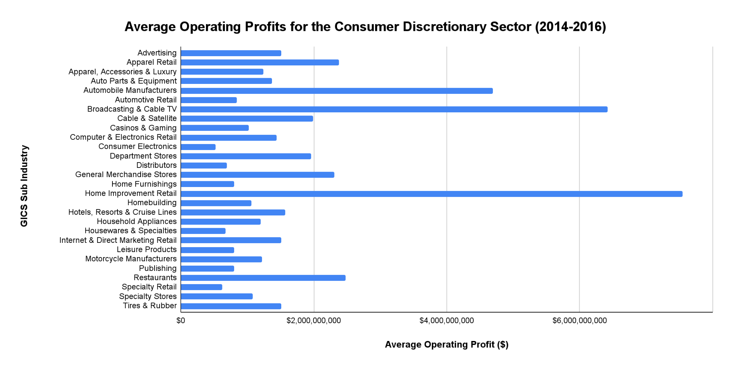
What are the average Operating Profits for the Consumer Discretionary sector from 2014-2016?
This bar chart illustrates the average operating profits for each sub industry in the Consumer Discretionary sector from 2014-2016.
The mean operating profit was $1,831,492,132.36, and the median operating profit was $1,302,822,270.83. There is a standard deviation of $1,685,397,069.13. This will result in a right-skewed or positively skewed distribution, due to the mean being greater than the median. With a range of $7,029,589,000 (Minimum = $523,911,000) this data displays large variability, and it may be more difficult to make predictions.
Nonetheless, the average operating profit for three sub industries were much higher than the overall mean. Those industries were Automotive Manufacturers ($4,696,833,333), Broadcasting and Cable TV ($6,424,784,250), and Home Improvement Retail ($7,553,500,000). Though, the companies in these sub industries had average operating margins of 3.01%, 28.1%, and 10.37%. By examining both metrics, Broadcasting and Cable TV is a sub industry that can be further evaluated for profitability and efficiency.
<visualization or summary statistics used for finding>

